Slide 1
The Dynamics Community

Slide 2
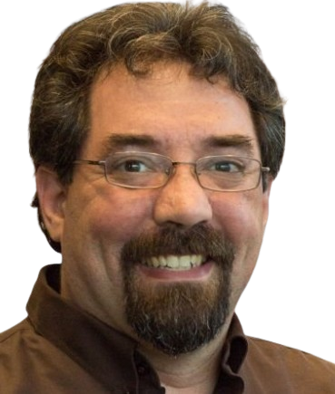
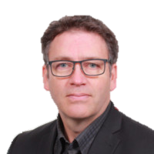

Your Speakers
Marcel Chabot
Software Development Practice Manager
A life-long software developer and “maker”, Marcel brings experience and a unique approach to complex problems and solutions in D365
Pierre Calder
President & Dynamics 365 Expert at Pro Services 365
Bringing extensive expertise in the implementation and optimization of enterprise solutions across the Microsoft ecosystem.
Notes:
Marcel: Brief talk about the automotive crash 17 years ago and switching to Business Software. Then again retooling from GP to BC. Community resources, community members, and mentors help me every step of the way.
Pierre:

Slide 3
Thanks to our local DUG.
Notes:
Khaled Nassra
Claud Rustom

Slide 4
What Brings Us Together?
Free food?
Products that help us run our business?
Amazing Community of People?
Notes:
People! People who are excited, engaged, knowledgeable. Any 2 of the three!

Slide 5
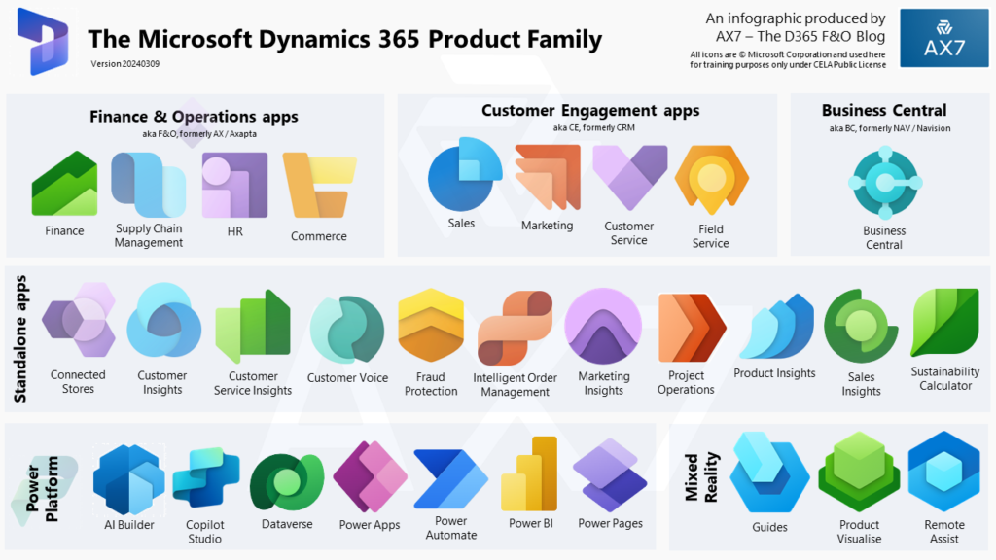
An Ecosystem for Everyone
Notes:
Cheer for your product!
Customer Engagement, I still call it CRM, I’m old, it’s okay.

Slide 6
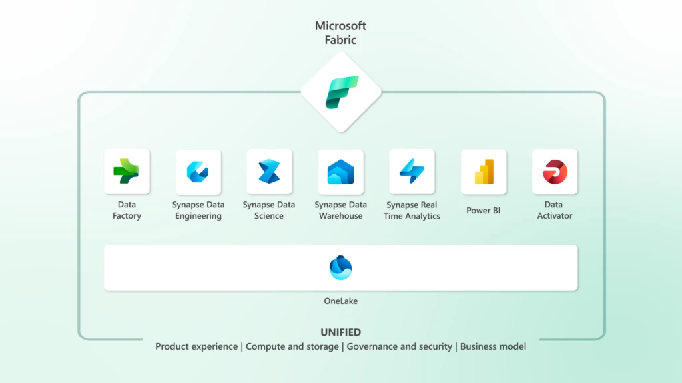
An Ecosystem for Everyone
Notes:
Add to that the capabilities of Azure!
There is also Azure Application Insights for performance monitoring.

Slide 7
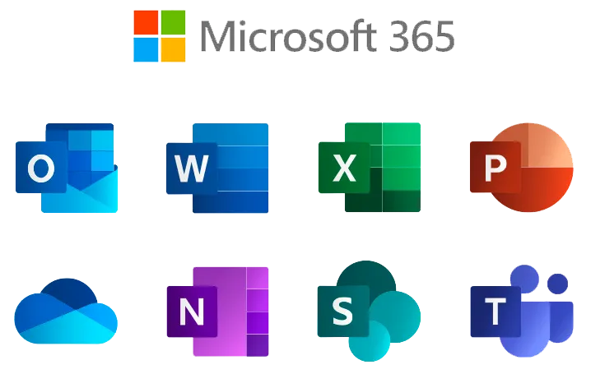
An Ecosystem for Everyone
Notes:
Everything interacting together with our Microsoft 365 products.

Slide 8

An Ecosystem for Everyone
Notes:
And Copilot helping bring that advanced AI dream to everyone.

Slide 9
That is a lot…
Notes:
Those are a lot of products. A lot of special skills. A lot of knowledge to manage all of that. Overwhelming? A little.
There is help!

Slide 10
The Dynamics ISV
Skilled Independent Software Vendors.
Constantly growing list of extensions available.
How do you know which one is right for you?
Notes:
ISVs are ready to use these technologies and refine them into verticals that are pertinent to your needs.
There are 1000s of ISVs providing solutions for every vertical (we call them verticals because calling our client problems is rude). Found one for managing farm animal husbandry… Tinder for cows basically.
Thank you for coming out today, round of applause for our ISVs.

Slide 11
The Dynamics VAR
Knowledgeable Value-Added Reseller.
Builds a relationship with ISVs.
Brings their skills to your business needs.
Notes:
VARs further specialize into verticals and help you bring your business requirements to life.
Implementation services
Provide some development services
Provide Support desk
A shoulder to cry on…
A round of applause for the VARs, clap super loud if your VAR is here.

Slide 12
The Microsoft MVP
A Microsoft MVP (Most Valuable Professional) is an individual recognized for their outstanding contributions to technical communities that utilize Microsoft technologies.
518+ Business Applications professionals willing to teach and explore new technologies with you.
Mvp.Microsoft.com to find an MVP in your area.
Notes:
You know how to tell if someone is a Microsoft MVP? Don’t worry, we’ll tell you. Stolen from Mary Myers.
Blogs, videos, linkedIn, Twitter, Facebook posts.
All free! Seriously, so much free support posed every month it is amazing. All for the community. We don’t get paid, we get a sticker.
MVPs please stand up and wave, these are the people you can ask the crazy questions too.

Slide 13

The Dynamics Community
Volunteer Coordinators
Volunteer Speakers
Excited to share products and technology with you.
Notes:
Speaker from across industry, sometimes overlapping, all agreeing to putdown competitive challenges to share with each other and grow the community.
This is what makes the Dynamics community different from so many others. We are willing to compete and collaborate, a rising tide lifts all ships.
DynamicsCon 2026 in Vegas May 12 – 16th

Slide 14
This is what sets us apart
The largest product Ecosystem.
The largest community.
The best people.

Slide 15
Thank you!

